Slide 1


Mini-Project Presentation-1
SESSION 2024-25
“VIRTUAL AI MOUSE”
Project Group Number: A -12
ABES Engineering College, Ghaziabad
Department of CSE-AIML
Project guide: Mr. NILESH KUMAR SEN
Team members:
1. ANUSHKA BANSAL ( 2300321530040)
2. ARCHIT VARSHNEY ( 2300321530043)
3. BHUMI BHARADWAJ ( 2300321530060)

Slide 2
Contents:
Abstract
Problem statement
Objectives
Literature Survey
Technical Requirements
References

Slide 3
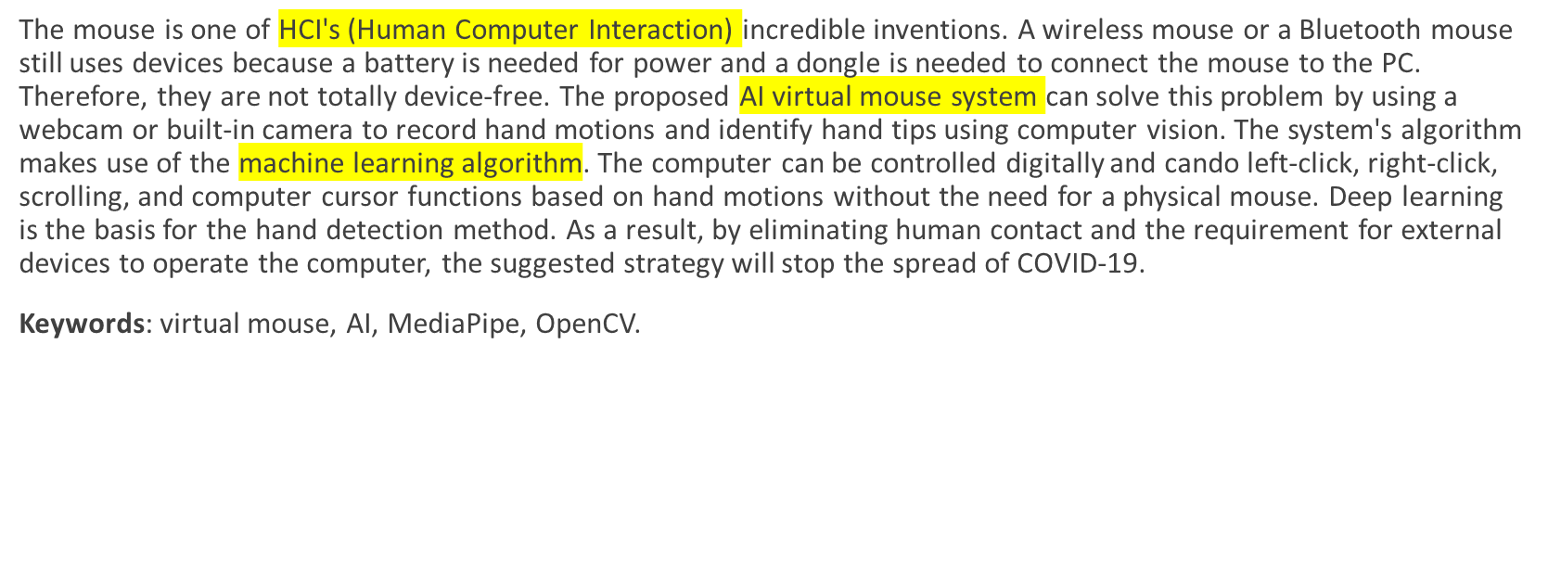
ABSTRACT:

Slide 4
OBJECTIVE:
Accuracy and Reliability : Achieve an accuracy rate of 95% or higher in hand gesture recognition, ensuring reliable and precise cursor movement and clicking functionality.
Cross-Platform Compatibility : Ensure compatibility with various camera technologies (e.g., RGB, depth sensors, stereo cameras) and operating systems (e.g., Windows, macOS, Linux), facilitating widespread adoption.
Real- time Responsiveness: Reduce latency and responsiveness time to ensure seamless interaction, providing an intuitive user experience.

Slide 5
PROBLEM STATEMENT:
Design a robust hand-tracking algorithm to accurately detect and track hand movements for virtual mouse cursor control.
Develop a system to accommodate users with disabilities or limited dexterity, ensuring accessible and inclusive interaction.
Investigate methods to reduce user fatigue and discomfort associated with prolonged hand gesture-based interaction.
Develop a gesture recognition system to differentiate between various hand gestures (e.g., pointing, clicking, scrolling) for virtual mouse interactions.

Slide 6
Literature Survey:
Reference | Author ,year | Objective | Technique used | Accuracy
[1] | MEENATCHI R (2023) |  | open-cv,Python,real time mouse system, Media-pipe , HCI | 85%
[2] | Mr.E.Sankar, B.Nitish Bharadwaj, A.V.Vignesh (May - 2023 ) |  | Human Computer Interaction, Python, Color Detection, Web camera, Hand Gestures. | 82%

Slide 7
Reference | Author ,year | Objective | Technique used | Accuracy
[3] | Kavitha R, Janasruthi S U, Lokitha S, Tharani G (2023 ) |  | Media pipe, open cv | 87%
[4] | Abhishek R. Shukla (Oct 2022) | To recognise hand gestures and track hands on a laptop, the MediaPipe framework and therefore the OpenCV package are both employed | Media pipe, open cv | 83%

Slide 8
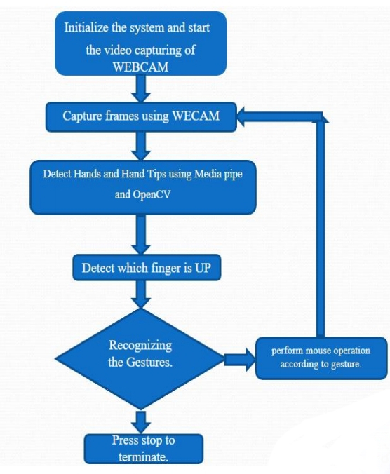
Flow graph of hand gesture recognition

Slide 9
TECHNICAL REQUIREMENTS:
Mediapipe framework : Google created the open-source MediaPipe framework to enable the development of cross-platform, real-time computer vision applications. For processing and analyzing video and audio streams, it offers a number of pre-made tools and components, such as object detection, pose estimation, hand tracking, facial recognition, and more.
1.Video and Audio Processing: MediaPipe provides tools for processing and analyzing video and audio
streams in real-time. This includes functionalities such as video decoding, filtering, segmentation, and
synchronization.
2. Facial Recognition: MediaPipe can detect and track facial landmarks, including eyes, nose, mouth, and
eyebrows, in real-time. This functionality is useful for applications such as facial recognition, emotion
detection, and augmented reality.

Slide 10
3. Hand Tracking: MediaPipe can track hand movements in real-time, allowing for hand gesture recognition and interaction with virtual objects.
4. Object Detection: MediaPipe can detect and track objects in real-time using machine learning models. This functionality is useful for applications such as augmented reality, robotics, and surveillance.
5. Pose Estimation: MediaPipe can estimate the poses of human bodies in real-time, allowing for applications such as fitness tracking, sports analysis, and augmented reality

Slide 11
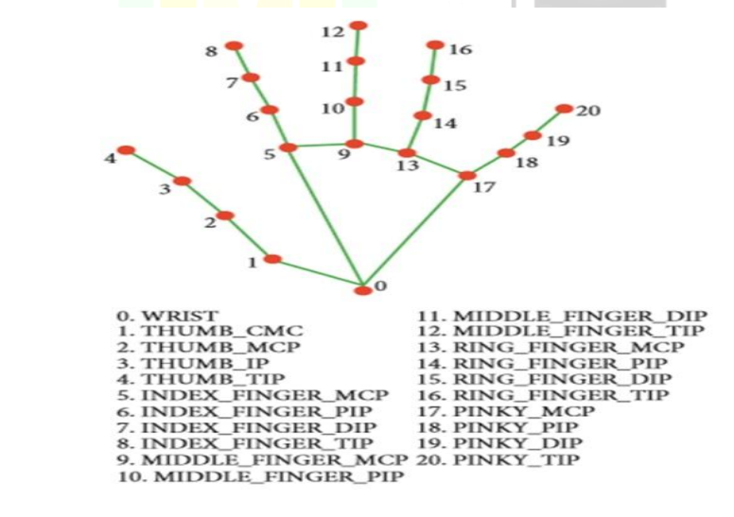

Slide 12
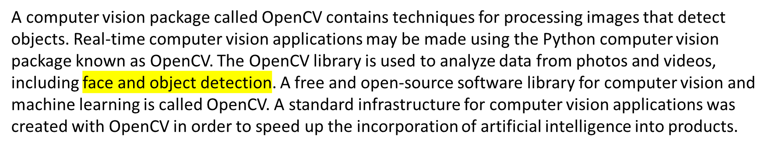
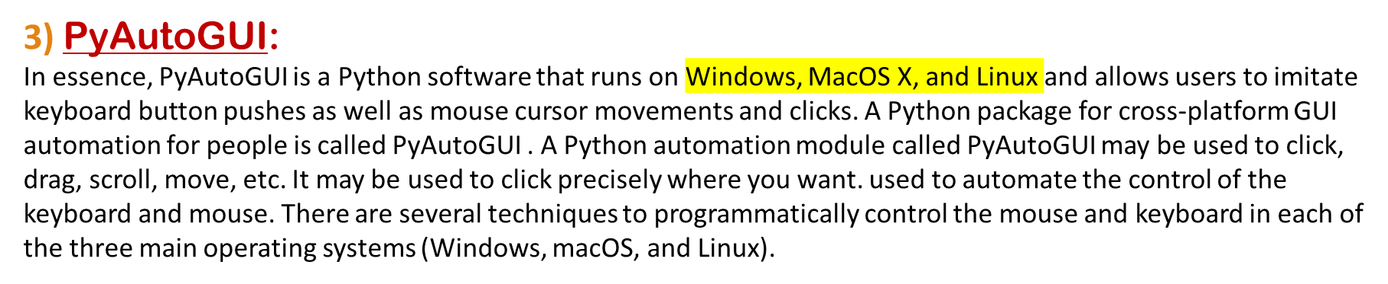
2) Opencv:

Slide 13
4) MATH:
A crucial component created to deal with mathematical operations is the Python math module. It has always been there and is supplied with the default Python version. The majority of the mathematical functions in the math module are only thin wrappers for the C platform's equivalents. The math module is effective and adheres to the C standard since its underlying functions are built in CPython. The Python math module gives you the possibility to perform common and useful mathematical operations within your programme. The Python math module offers a number of pre-set constants. There are many advantages to having access to these constants. One advantage is that by not having to manually hardcode them into your programme, you might save a lot of
time. They also guarantee consistency throughout your entire code.

Slide 14
ALGORITHM
Step 1: Start the program.
Step 2: Open the file and using that file location go to cmd.
Step 3: Using some libraries installed for the code run the program.
Step 4: Initialize the system and start the video capturing of WEBCAM.
Step 5: Capture frames using WECAM.
Step 6: Detect Hands and Hand Tips using Media pipe and OpenCV.
Step 7: Detect which finger is UP.
Step 8: Recognizing the Gesture.
Step 9: Perform mouse operations according to gesture.
Step 10: Stop the program.

Slide 15
APPLICATIONS:
The virtual mouse system using Artificial Intelligence can be used in many areas; it is useful in reducing the space requirements for using the physical mouse, and worked as an alternative for a traditional physical mouse.
Few applications of proposed system are:-
Because of COVID-19 pandemic, the use of physical devices is not safe as it may spread the virus by using physical devices as they need to be touched. Thus, the virtual mouse is an option to perform functions of mouse by recognizing hand gestures.
Virtual mouse is helpful in robotics and automation industries to control robots without the use of physical devices.
2-D & 3-D pictures can be created through AI based virtual devices through hand gestures.
AI based virtual mouse can be utilized in the field of VR and AR based games, which eliminates the need of mouse devices. People with disabled hands utilize this system to perform the various functions of mouse on the computer screen.
The proposed method may be used for virtual prototyping and development in the disciplines of architecture and design.

Slide 16
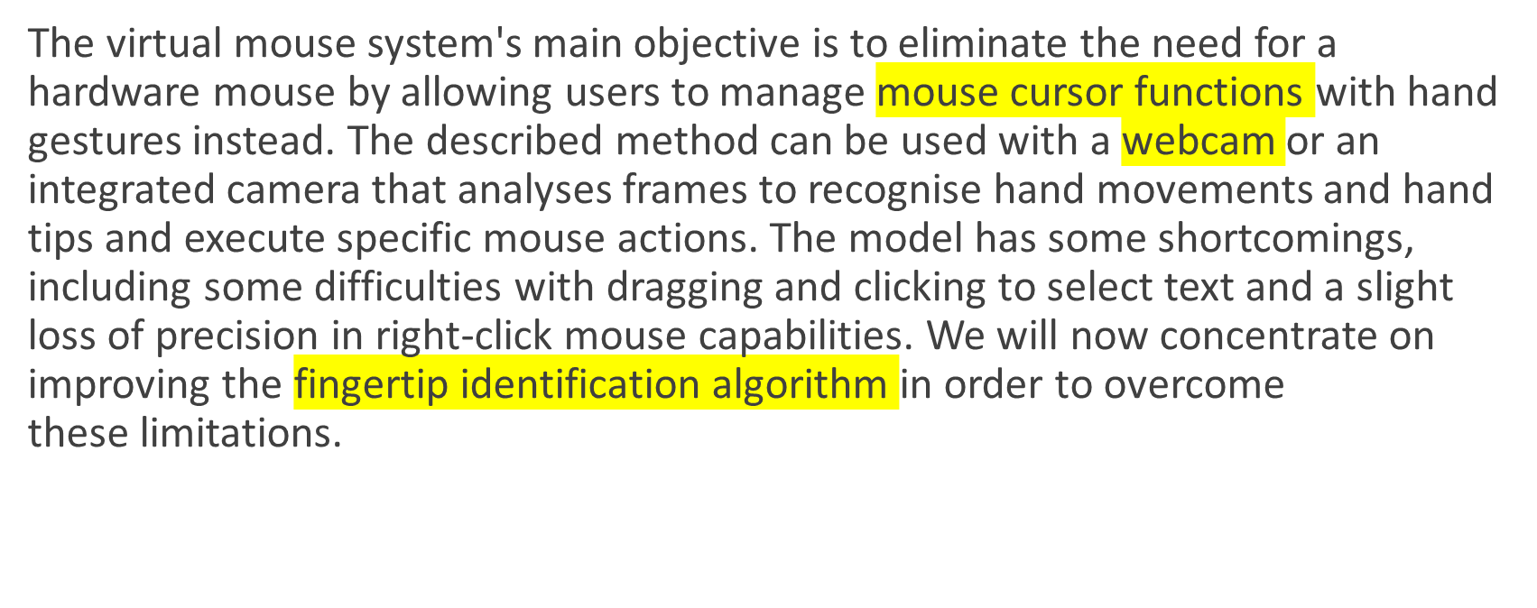
CONCLUSION:

Slide 17
REFRENCES
Danckert, J., Goodale, M.A., 2001. Superior performance for visually guided pointing in the lower visual field. Exp. Brain Res. 137, 303–308. https://doi.org/10.1007/s002210000653.
Carlton, B., 2021. HaptX Launches True-Contact Haptic Gloves For VR And Robotics. VRScout. URL https://vrscout.com/news/haptx-truecontact-hapticgloves-vr/ (accessed 3.10.21).
Brenton, H., Gillies, M., Ballin, D., Chatting, D., 2005. D.: The uncanny valley: does it exist, in: In: 19th British HCI Group Annual Conference: Workshop on Human-Animated Character Interaction.
Buckingham, G., Michela kakis, E.E., Cole, J., 2016. Perceiving and acting upon weight illusions in the absence of somatosensory information. J. Neurophysiol. 115, 1946–1953. https://doi.org/10.1152/jn.00587.2015.

Slide 18
Guha, Joy, et al. “AI Virtual Mouse Using Hand Gesture Recognition.” International Journal for Research in Applied Science and Engineering Technology, vol. 10, no. 4, International Journal for Research in Applied Science and Engineering Technology (IJRASET), Apr. 2022, pp. 3070–76. Crossref, https://doi.org/10.22214/ijraset.2022.41981.
A, Mr. Venkateshwar. “Hand Gesture Recognition System as Virtual Mouse for HCI.” International Journal for Research in Applied Science and Engineering Technology, vol. 9, no. 8, International Journal for Research in Applied Science and Engineering Technology (IJRASET), Aug. 2021, pp. 1098–101. Crossref, https://doi.org/10.22214/ijraset.2021.37503.
“VIRTUAL MOUSE USING HAND GESTURE.” International Journal of Modern Trends in Engineering & Research, vol. 4, no. 3, International Journal of Modern Trends in Engineering and Research, Mar. 2017, pp.5–9.Crossref, https://doi.org/10.21884/ijmter.2017.4069.3wz5x

Slide 19
THANK YOU

